Slide 1
Hostel management system
Presentation by
Parth Desai – (202003103410001)
Pooja Patel – (202006100110037)
Guided by
Dr. Sapan Naik

Slide 2
Agenda
1. Introduction
2. Overall Description
3. System Specific Requirements
4. System Design
5. Diagrams

Slide 3
1.
Introduction

Slide 4
Problem Definition
A Hostel/Chain of Hostel is an essential part of an Institute along with educational curriculum. Every year hundreds of
students takes admission and decides to stay in Hostel. It Provides a space to students who are unable to travel a lot or
who are living much far away from the institute or are unaware of the surroundings to live with. The best hostel
management systems not only allow the admin, owner or staff members to manage the various aspects of the business
from one location, they offer the possibility for users to access the system remotely, and the information that is
updated within the system to all the users automatically.

Slide 5
Problem Definition
Finding a PG is not easy sometimes because there are lots of essential tasks that are needed to be done in order to
finalize a place to live-in such as finding a good PG situated not very far from the institute, availability of the life
essential things, amenities etc. and importantly, living in a Hostel helps students save their traveling time and utilize
this time into many different useful areas. Therefore, a good platform must be required to provide all the useful
privileges to find a Hostel and book a place that comforts them.

Slide 6
Project Objective
Dormzz: The Hostel Management System allows to use wide range of loaded features online which are usually not
provided to the students or staff members due to unapproachable resources. Given below are the key
features of the system that the students and staff will be able to use:
Booking Rooms
Online Payment
Saving Transportation Time
Daily Activities and Games
Cleanliness and Hygiene
Counseling
Events
Proper Maintained Schedule
Immediate Health assist/support.

Slide 7
Project Scope
The Scope of the system is limited to the stack holders of the Uka Tarsadia University, Bardoli. Viz. Admin, Staff
and Students. This system is designed to be used for the long period of time over the number of new batches.

Slide 8
2. Overall Description

Slide 9
Hardware Specification
Device name : PARTHs-DESKTOP
Processor : Intel(R) Core (TM) i5-1035G1 CPU @ 1.00GHz 1.19 GHz
Installed RAM : 16.0 GB
System type : 64-bit operating system, x64-based processor
Hard Disk : 512 GB

Slide 10
Software Specification
Operating System : Microsoft Windows 11
Front End : HTML, CSS, JS, Bootstrap
Back End : MySQL, PHP
Input Device : Keyboard, Mouse
Output Device : Monitor, Printer
Software Used : Visual Studio Code (Version 1.69.0), Brave Browser
Tools : Xampp (Version 3.3.0), Apache NetBeans IDE 14

Slide 11
3. System Specific Requirements

Slide 12
Functional Requirements
Registration
View Dashboard
Book Rooms
1
3
5
2
4
6
Login
Manage User Profiles (All users)
Manage Rooms

Slide 13
Functional Requirements
Manage Mess Information
Manage Leaves
Manage Complains
8
10
12
7
9
11
Manage Packages
Manage Events / Activities
Manage Requests

Slide 14
Functional Requirements
Manage Duties
Add contact details
13
15
14
16
Manage
Feedbacks, Ratings
Manage
Posts/Notices

Slide 15
Non-Functional Requirements
Security
The System will be able to Manage stored Payment Options
Availability
The System will be able to provide all the necessary data under regular traffic as well as critical situations.
Reliability
The System will be reliable on Enrollment Number and Institute Id.
Useability
The System will be able to Provide Easy-to-Use Interface to for Users.
Compatibility
The System will be compatible with different OS and Devices.
Simplicity
The System will be able to perform simple tasks and Operations.

Slide 16
4. System Design

Slide 17
Database Schema
1. Table Name : tblRegister
tblRegister (user_id[PK], EnrollmentNo, CourseName, DepartmentName, Username, Password, FirstName, LastName, Gender, Email, PhoneNo)
2. Table Name : tblStudent
tblStudent (user_id[PK], Club_id[FK], Profile_img)
3. Table Name : tblStaff
tblStaff (user_id[PK], role_id[FK],)
4. Table Name : tblRole
tblRole(role_id[PK], role_type)
5. Table Name : tblUserType
tblType (UType_id[PK], UType)
6. Table Name : tblHostel
tblHostel (Hostel_id[PK], Capacity, Hostel_Name, Hostel_Category, Hostel_Status, Hostel_Distance, Hostel_Type, Available_Rooms, user_id[FK], Mess_ID[FK], Address)
7. Table Name : tblRoom
tblRoom (Room_id[PK], Room_Type_id[FK], Hostel_id[FK])

Slide 18
Database Schema
8. Table Name : tblRoomType
tblRoom (Room_Type_id[PK], Room_Type, Room_Capacity, Room_Facilities_id[FK])
9. Table Name : tblRoomFacilities
tblRoomFacilities (Room_Facilities_id[PK], Room_Facilities)
10. Table Name : tblMess
tblMess(Mess_id[PK], Caterer_Name, user_id[FK], role_id[FK], MessMenu_id[FK])
11. Table Name : tblMess_Menu
tblMess_Menu(MessMenu_id[PK], Day, Time, Dish_id[FK])
12. Table Name : tblDish
tblMess(Dish_id[PK], DishName)
13. Table Name : tblPackage
tblPackage (Package_id[PK], Package_Name, Package_Description, Package_Valid_Year)
14. Table Name : tblHostel_Record
tblHostel_Record (Record_id[PK], user_id[FK], Hostel_id[FK], Room_id[FK], Room_Type_id[FK], Timestamp_Check_Out, Timestamp_Check_In, User_Status)

Slide 19
Database Schema
15. Table Name : tblTransaction
tblTransaction (Trn_id[PK], user_id[FK], Record_id[FK], Package_id[FK], Trn_Timestamp, Trn_Amount, Trn_Mode, Trn_refference_id, Trn_Status)
16. Table Name : tblComplain
tblComplain (Cmp_id[PK], Cmp_Type_id[FK], user_id[FK], Cmp_Timestamp, Cmp_Brief, Cmp_Reply, Cmp_Status)
17. Table Name : tblComplain_Type
tblComplain_Type ( Cmp_Type_id[PK], Cmp_Type)
18. Table Name : tblRequest
tblRequest (Req_id[PK], user_id[FK], Req_Timestamp, Req_Brief, Req_Remarks, Req_Status)
19. Table Name : tblFeedback
tblFeedback (Fdb_id[PK], user_id, Fdb_Timestamp, Fdb_Brief)
20. Table Name : tblEvent
tblEvent (Event_id[PK], Event_Name, Event_Date)
21. Table Name : tblClub
tblClub (Club_id[PK], Club_Name, user_id, Event_id)

Slide 20
Database Schema
22. Table Name : tblNotice
tblNotice (Notice_id[PK], Notice_Brief, user_id, Notice_Timestamp )
23. Table Name : tblLeave
tblLeave (Leave_id[PK], user_id[FK], Leave_Reason, Leave_From, Leave_To, Leave_Status)

Slide 21
Data Dictionary
tblRegister
Field Name Datatype Size Constraint Description
user_id int 7 Primary Key Unique id of Users
EnrollmentNo big int 9 Not Null Enrollment Numbers of User
CourseName Varchar Max Not Null Current Course Pursuing
DepartmentName Varchar Max Not Null Department Name
Username Varchar 100 Not Null User Account id
Password Varchar 50 Not Null User Account Password
FirstName Varchar 100 Not Null First Name of the User
LastName Varchar 100 Not Null Last Name of the User
Gender Varchar 10 Not Null Gender of User
Email Varchar Max Not Null Email id of the User
PhoneNo Numeric 10 Not Null Phone number of the User
tblStudent
Field Name Datatype Size Constraint Description
user_id int 7 Primary Key Unique id of Users
Club_id int 6 Foreign Key Unique id of Club
Profile_img Varchar 800 Default Default Path of Profile Pic

Slide 22
Data Dictionary
tblStaff
Field Name Datatype Size Constraint Description
user_id int 7 Primary Key Unique id of Users
Role_id int 5 Foreign Key Unique id of Role
tblRole
Field Name Datatype Size Constraint Description
Role_id Int 5 Primary Key Unique id of Role Type
Role_Type Varchar 100 Not Null Type of Role
tblUserType
Field Name Datatype Size Constraint Description
UType_id Int 3 Primary Key Unique id of Type Users
UType Varchar 8 Not Null
tblRoom
Field Name Datatype Size Constraint Description
Room_id Varchar 5 Primary Key Unique id of Room
Room_Type_id Varchar 4 Foreign Key Unique id of Room Type
Hostel_id int 7 Foreign Key Unique id of Hostel

Slide 23
Data Dictionary
tblHostel
Field Name Datatype Size Constraint Description
Hostel_id Int 7 Primary Key Unique id of Hostel
Capacity Int 3 Not Null Capacity of a Hostel
Hostel_Name Varchar 500 Not Null Name of the Hostel
Hostel_Category Varchar 50 Not Null Category of Hostel (Male/Female)
Hostel_Status Varchar 100 Not Null Status of Hostel
Hostel_Distance Int 3 Not Null Distance of Hostel from Campus
Hostel_Type Varchar 200 Not Null Type of Hostel
Available_Rooms Int 100 Not Null Availability of the Rooms
user_id Int 7 Foreign Key Unique Staff id of Rector
Mess_id Int 3 Foreign Key Unique Mess id of Mess
Address Address 500 Not Null Address of the Hostel
tblRoomType
Field Name Datatype Size Constraint Description
Room_Type_id Varchar 5 Primary Key Unique id of Room Type
Room_Type Varchar 20 Not null Type of Room
Room_Capacity int 2 Not null Capacity of the Room
Room_Facilities_id Varchar 25 Foreign Key Unique id of Facilities Provided

Slide 24
Data Dictionary
tblRoomFacilities
Field Name Datatype Size Constraint Description
Room_Facilities_id Varchar 5 Primary Key Unique id of Facilities Provided
Room_Facilities Varchar Max Not Null Facilities Provided in Rooms
tblMess
Field Name Datatype Size Constraint Description
Mess_id int 3 Primary Key Unique id of Mess
Cateres_Name Varchar Max Not Null Name of Mess Cateres
user_id int 7 Foreign Key Unique id of Staff Members only
Role_id int 5 Foreign Key Unique id of Role Type
MessMenu_id Varchar 5 Foreign Key Unique id of Mess Menu
tblMess_Menu
Field Name Datatype Size Constraint Description
MessMenu_id Varchar 5 Primary Key Unique id of Mess Menu
Day Date Not Null Day of Menu Applicable
Time DateTime Not Null Time of Day Menu Applicable
Dish_id Varchar 6 Foreign Key Unique id of Dishes

Slide 25
Data Dictionary
tblDish
Field Name Datatype Size Constraint Description
Dish_id Varchar 6 Primary Key Unique id of Dishes
DishName Varchar Max Not Null Name of Dishes
tblPackage
Field Name Datatype Size Constraint Description
Package_id Varchar 7 Primary Key Unique id of Packages
Package_Name Varchar 50 Not Null Name of Package
Package_Description Varchar Max Not Null Description about Package
Package_Valid_Year Date Not Null Date of Package Validity
tblNotice
Field Name Datatype Size Constraint Description
Notice_id Varchar 9 Primary Key Unique id of Notice
Notice_Brief Varchar Max Not Null Notice in Brief
user_id int 7 Foreign Key Unique id of Users
Notice_Timestamp Datetime Not Null Timestamp of Notice Generated

Slide 26
Data Dictionary
tblHostel_Record
Field Name Datatype Size Constraint Description
Record_id Varchar 10 Primary Key Unique id of Hostel Record
user_id Int 7 Foreign Key Unique id of Users
Hostel_id Int 7 Foreign Key Id of Hostel
Room_id Varchar 5 Foreign Key Unique id of Room
Timestamp_Check_Out DateTime Not Null Timestamp of Check out
Timestamp_Check_In DateTime Not Null Timestamp of Check in
User_Status Varchar 7 Not Null Status of User Account
tblTransaction
Field Name Datatype Size Constraint Description
Trn_id Varchar 12 Primary Key Unique id of Transaction
user_id int 7 Foreign Key Unique id of Users
Record_id Varchar 10 Foreign Key Unique id of Hostel Record
Trn_Timestamp Date Not Null Timestamp of Transaction
Trn_Amount Double 6 Not Null Amount of Hostel Fees / Package
Trn_Mode Varchar 20 Not Null Mode of Transaction / Payment
Trn_refference_id Varchar 15 Not Null Reference number of Transaction
Trn_Status Varchar 10 Not Null Status of the Transaction

Slide 27
Data Dictionary
tblComplain_Type
Field Name Datatype Size Constraint Description
Cmp_Type_id Varchar 5 Primary Key Unique id of Complain Type
Cmp_Type Varchar 9 Not Null Type of Complain
tblComplain
Field Name Datatype Size Constraint Description
Cmp_id Varchar 9 Primary Key Unique id of Complain
Cmp_Type_id Varchar 5 Foreign Key Unique id of type of Complain
user_id int 7 Foreign Key Unique id of Users
Cmp_Timestamp DateTime Not Null Timestamp of Complain Generated
Cmp_Brief Varchar Max Not Null Complain in Brief
Cmp_Remarks Varchar Max Null Reply of the Complain
Cmp_Status Varchar 10 Not Null Status of the Complain
tblFeedback
Field Name Datatype Size Constraint Description
Fdb_id Varchar 9 Primary Key Unique id of Feedback
user_id int 7 Primary Key Unique id of Users
Fdb_Timestamp DateTime Not Null Feedback Timestamp
Fdb_Brief Varchar Max Not Null Feedback of the User

Slide 28
Data Dictionary
tblRequest
Field Name Datatype Size Constraint Description
Req_id Varchar 9 Primary Key Unique id of Request
user_id int 7 Foreign Key Unique id of Users
Req_Timestamp DateTime Not Null Timestamp of Request Generated
Req_Brief Varchar Max Not Null User Account Password
Req_Remarks Varchar Max Null Reply of the Request
Req_Status Varchar 10 Not Null Status of the Request
tblEvent
Field Name Datatype Size Constraint Description
Event_id Varchar 8 Primary Key Unique id of Events
Event_Name Varchar Max Not Null Name of the Event
Event_Date DateTime Not Null Date and Time of the Event
tblClub
Field Name Datatype Size Constraint Description
Club_id int 7 Primary Key Unique id of Club
Club_Name Varchar 100 Not Null Name of the Club
user_id int 7 Foreign Key Unique id of Users
staff_id int 7 Foreign Key Unique id of Staff Member

Slide 29
Data Dictionary
tblLeave
Field Name Datatype Size Constraint Description
Leave_id Varchar 9 Primary Key Unique id of Blog
User_id int 7 Foreign Key Unique id of User
Leave_Reason Varchar 100 Not Null Title of the Blog
Leave_From DateTime Not Null Timestamp of Leave Starting Day
Leave_To DateTime Not Null Timestamp of Leave Ending Day
Leave_Status Varchar 10 Not Null Status of the Leave

Slide 30
5. Diagrams

Slide 31
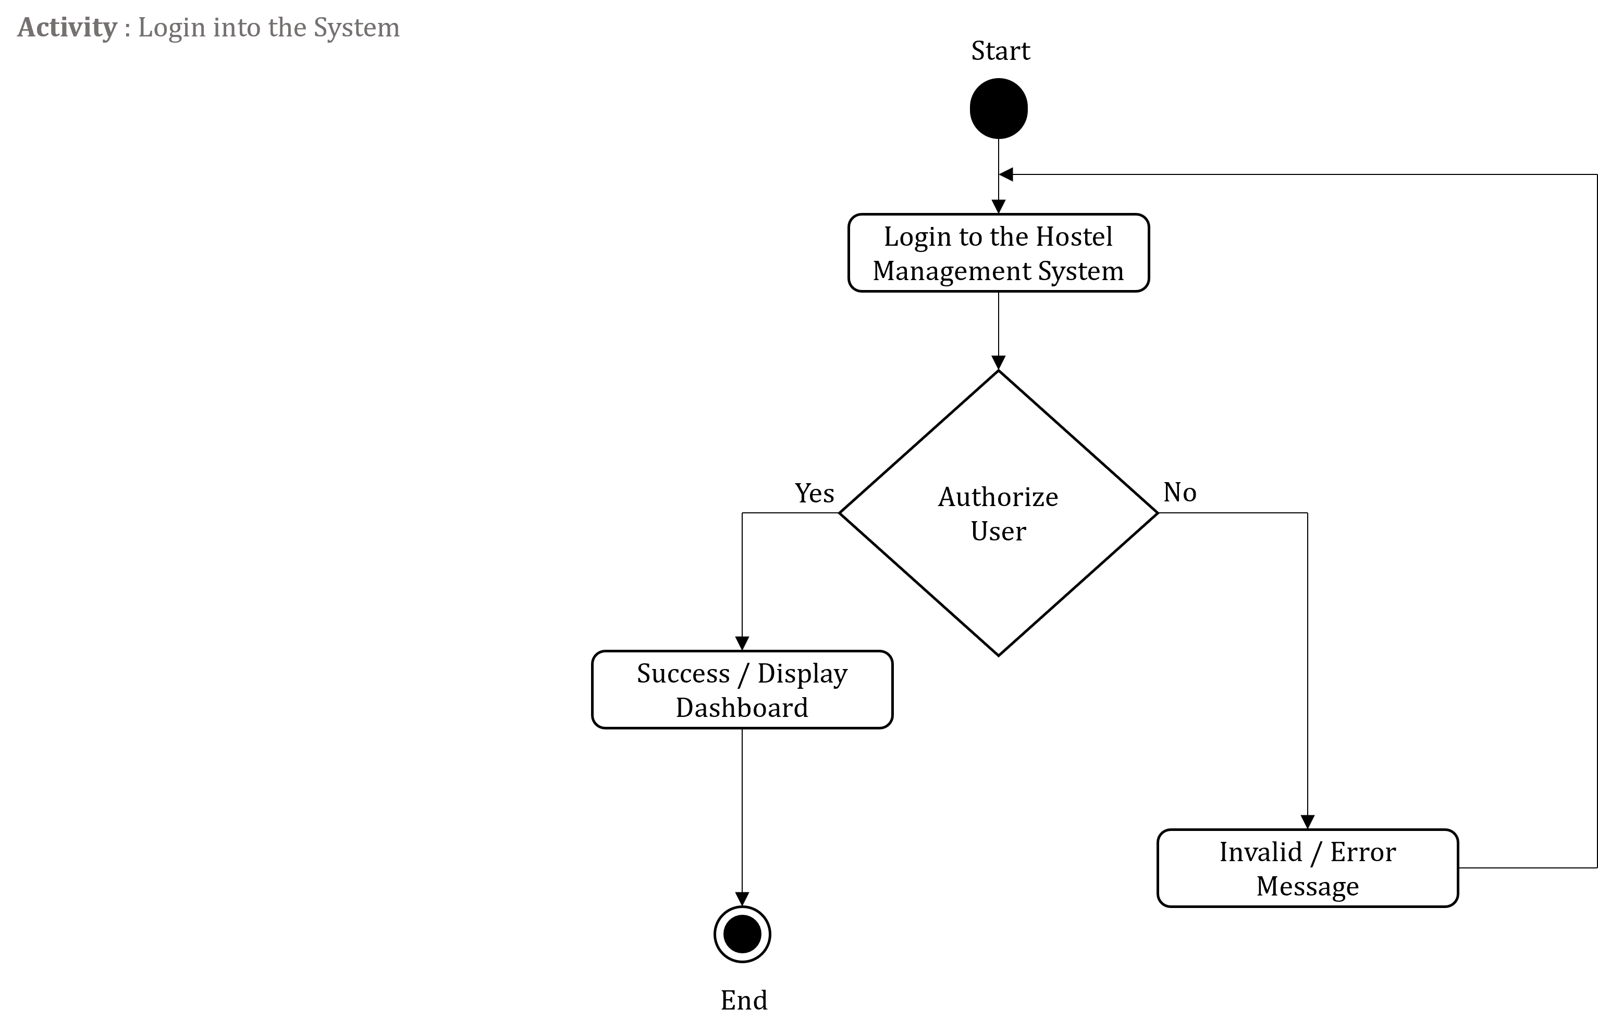
Activity Diagrams

Slide 32
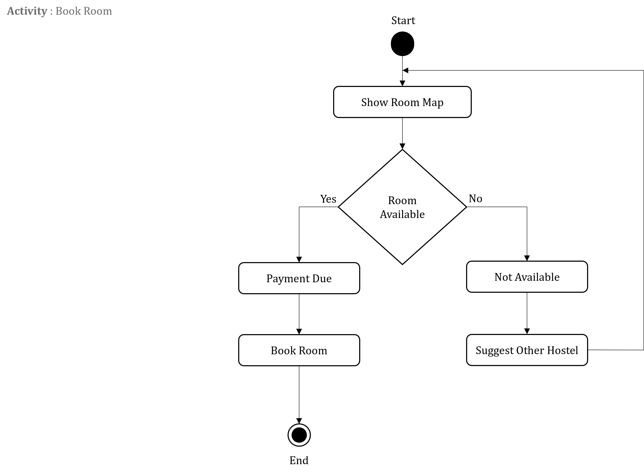
Activity Diagrams

Slide 33
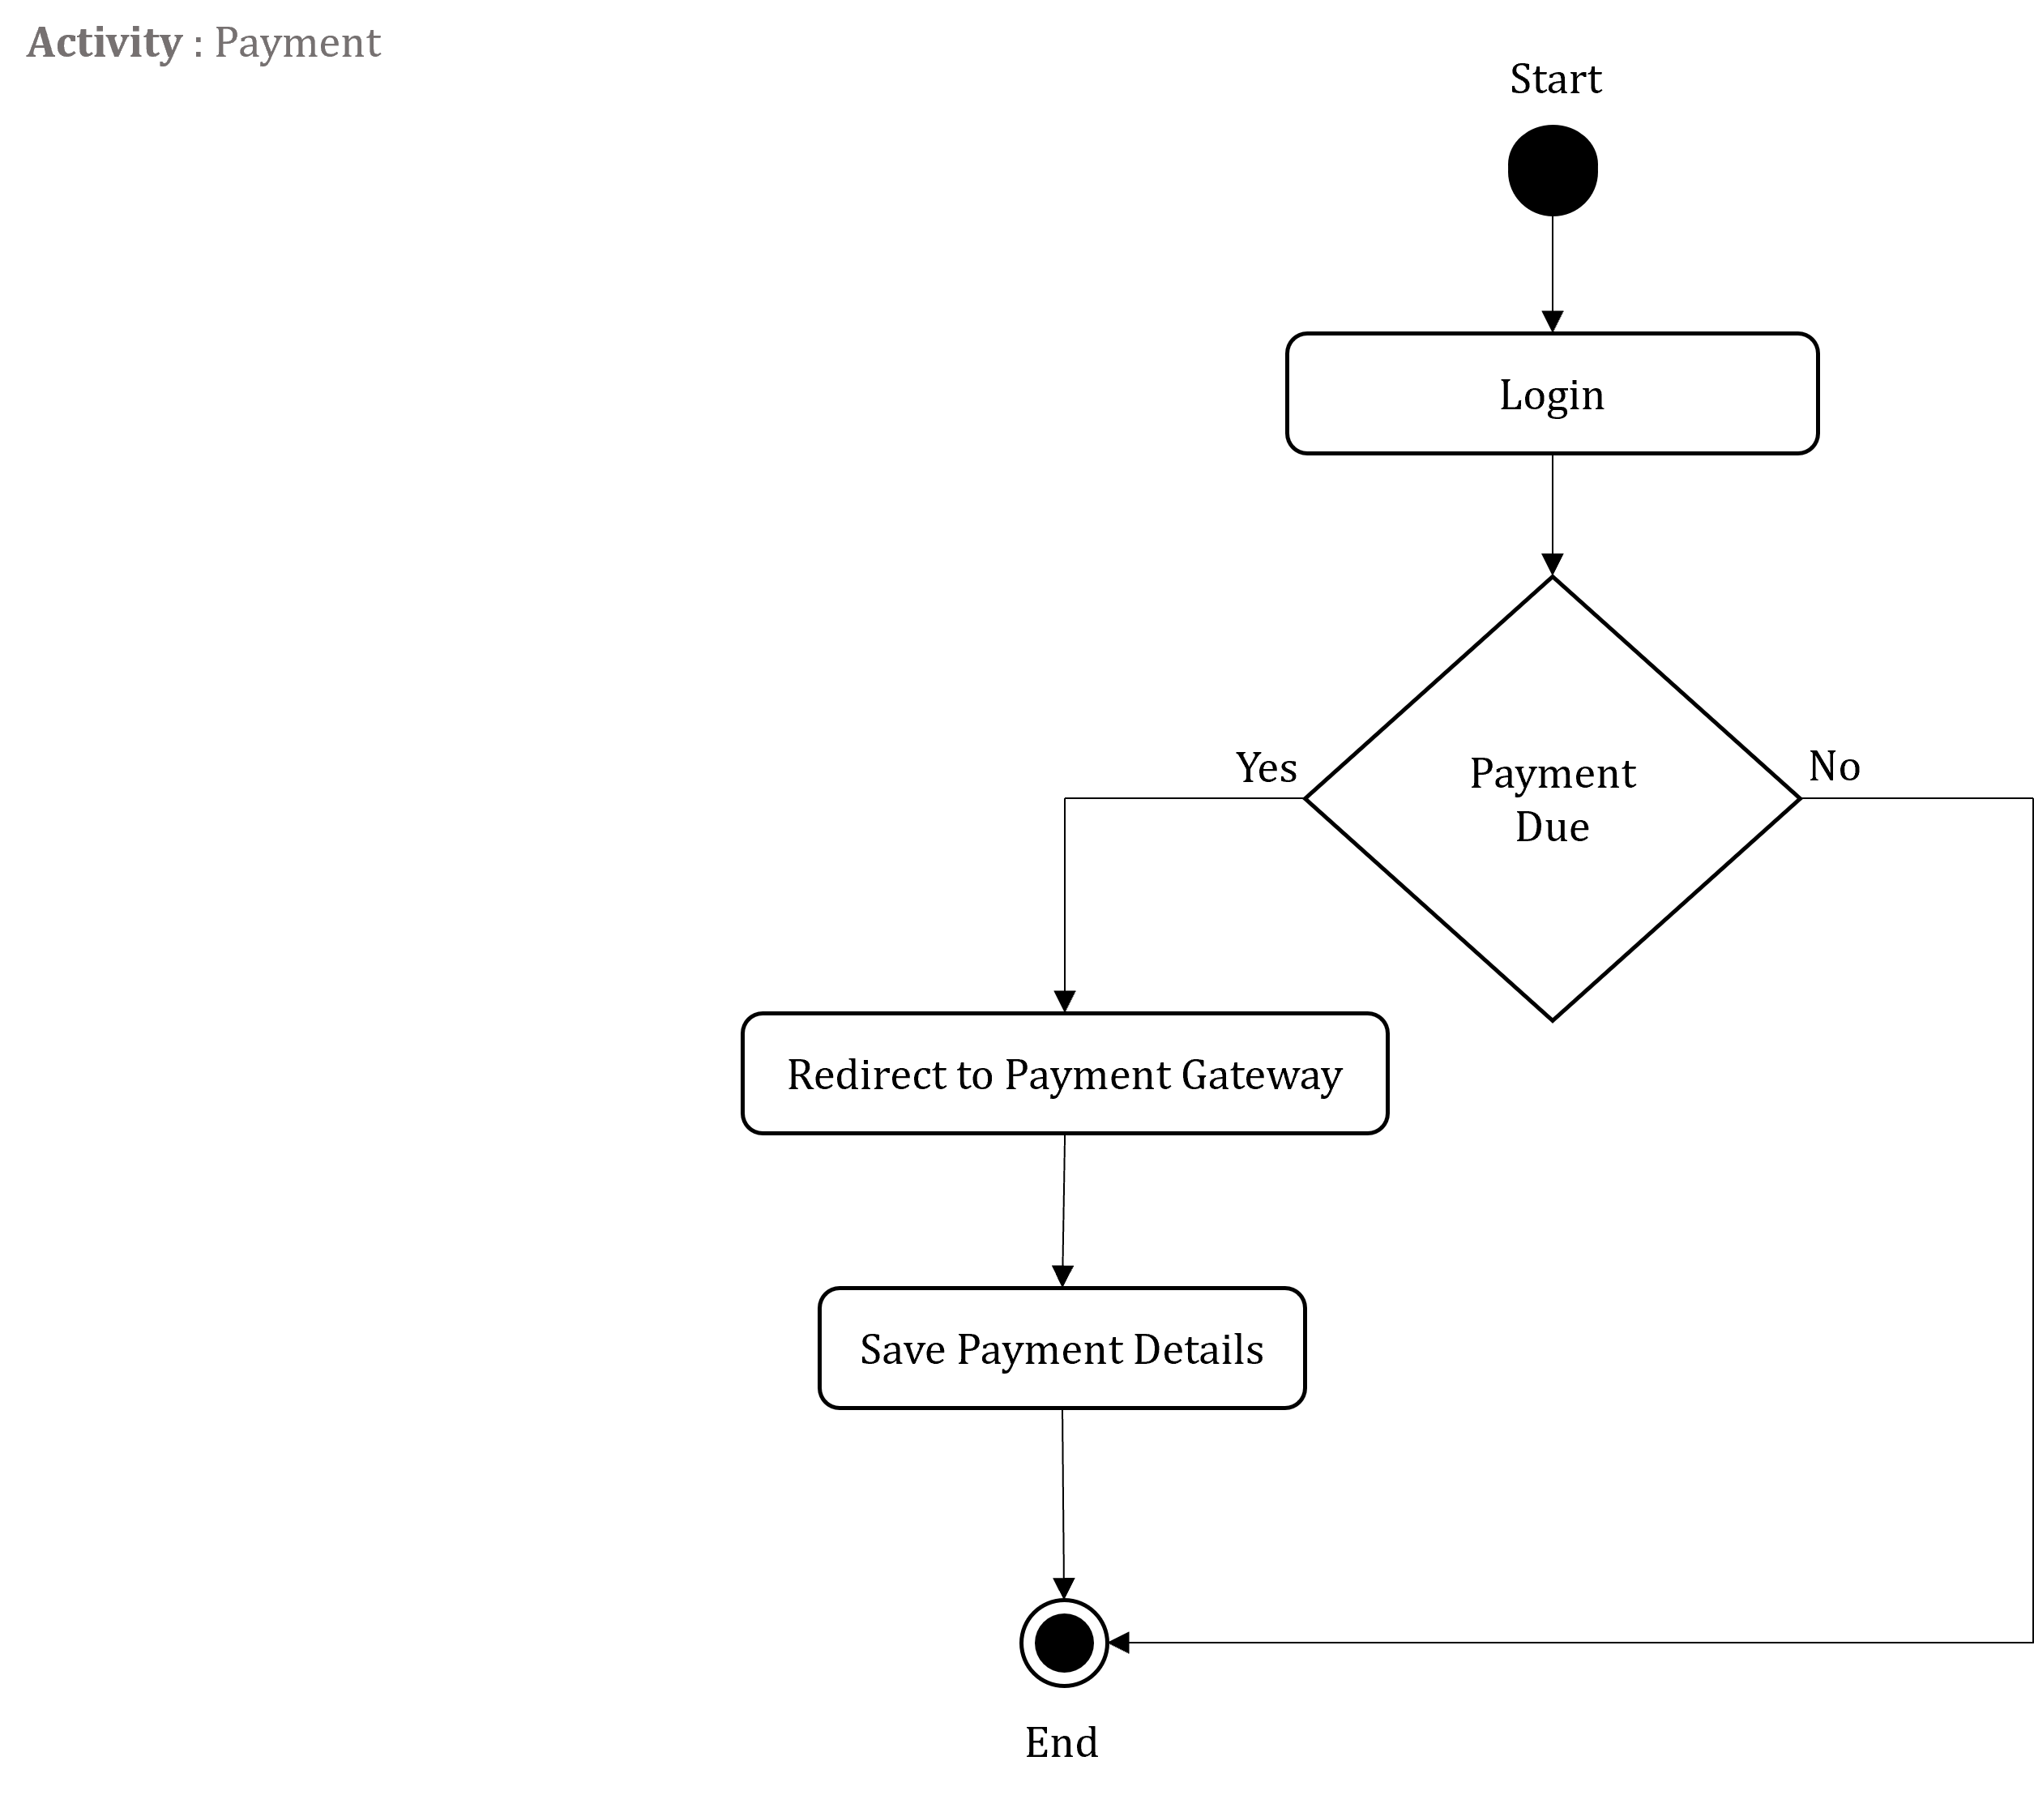
Activity Diagrams

Slide 34
Activity Diagrams

Slide 35
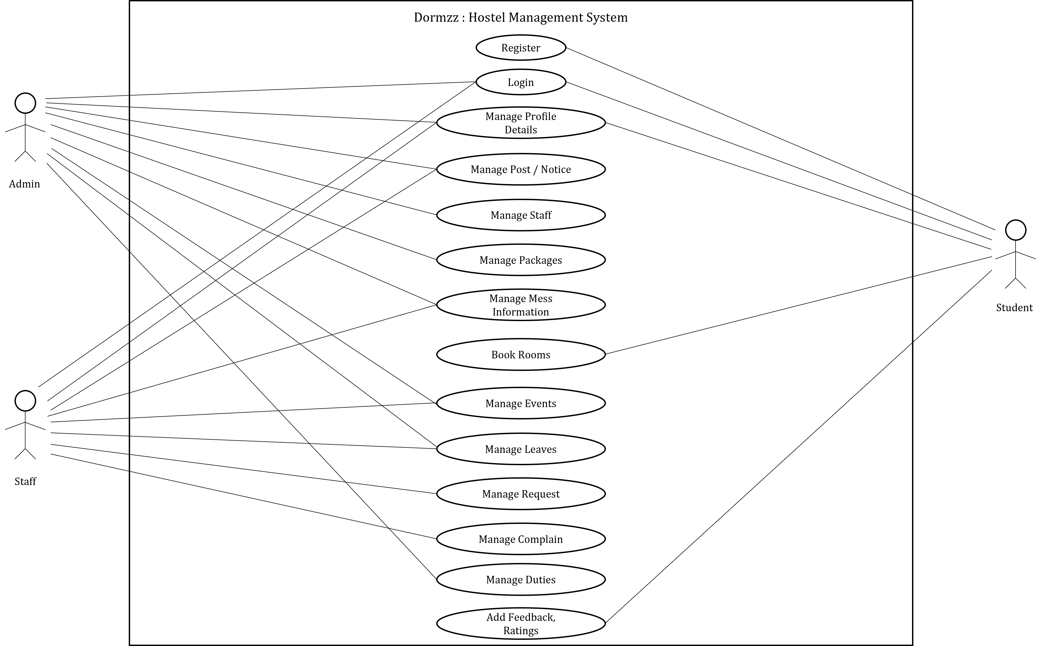
Usecase Diagrams

Slide 36
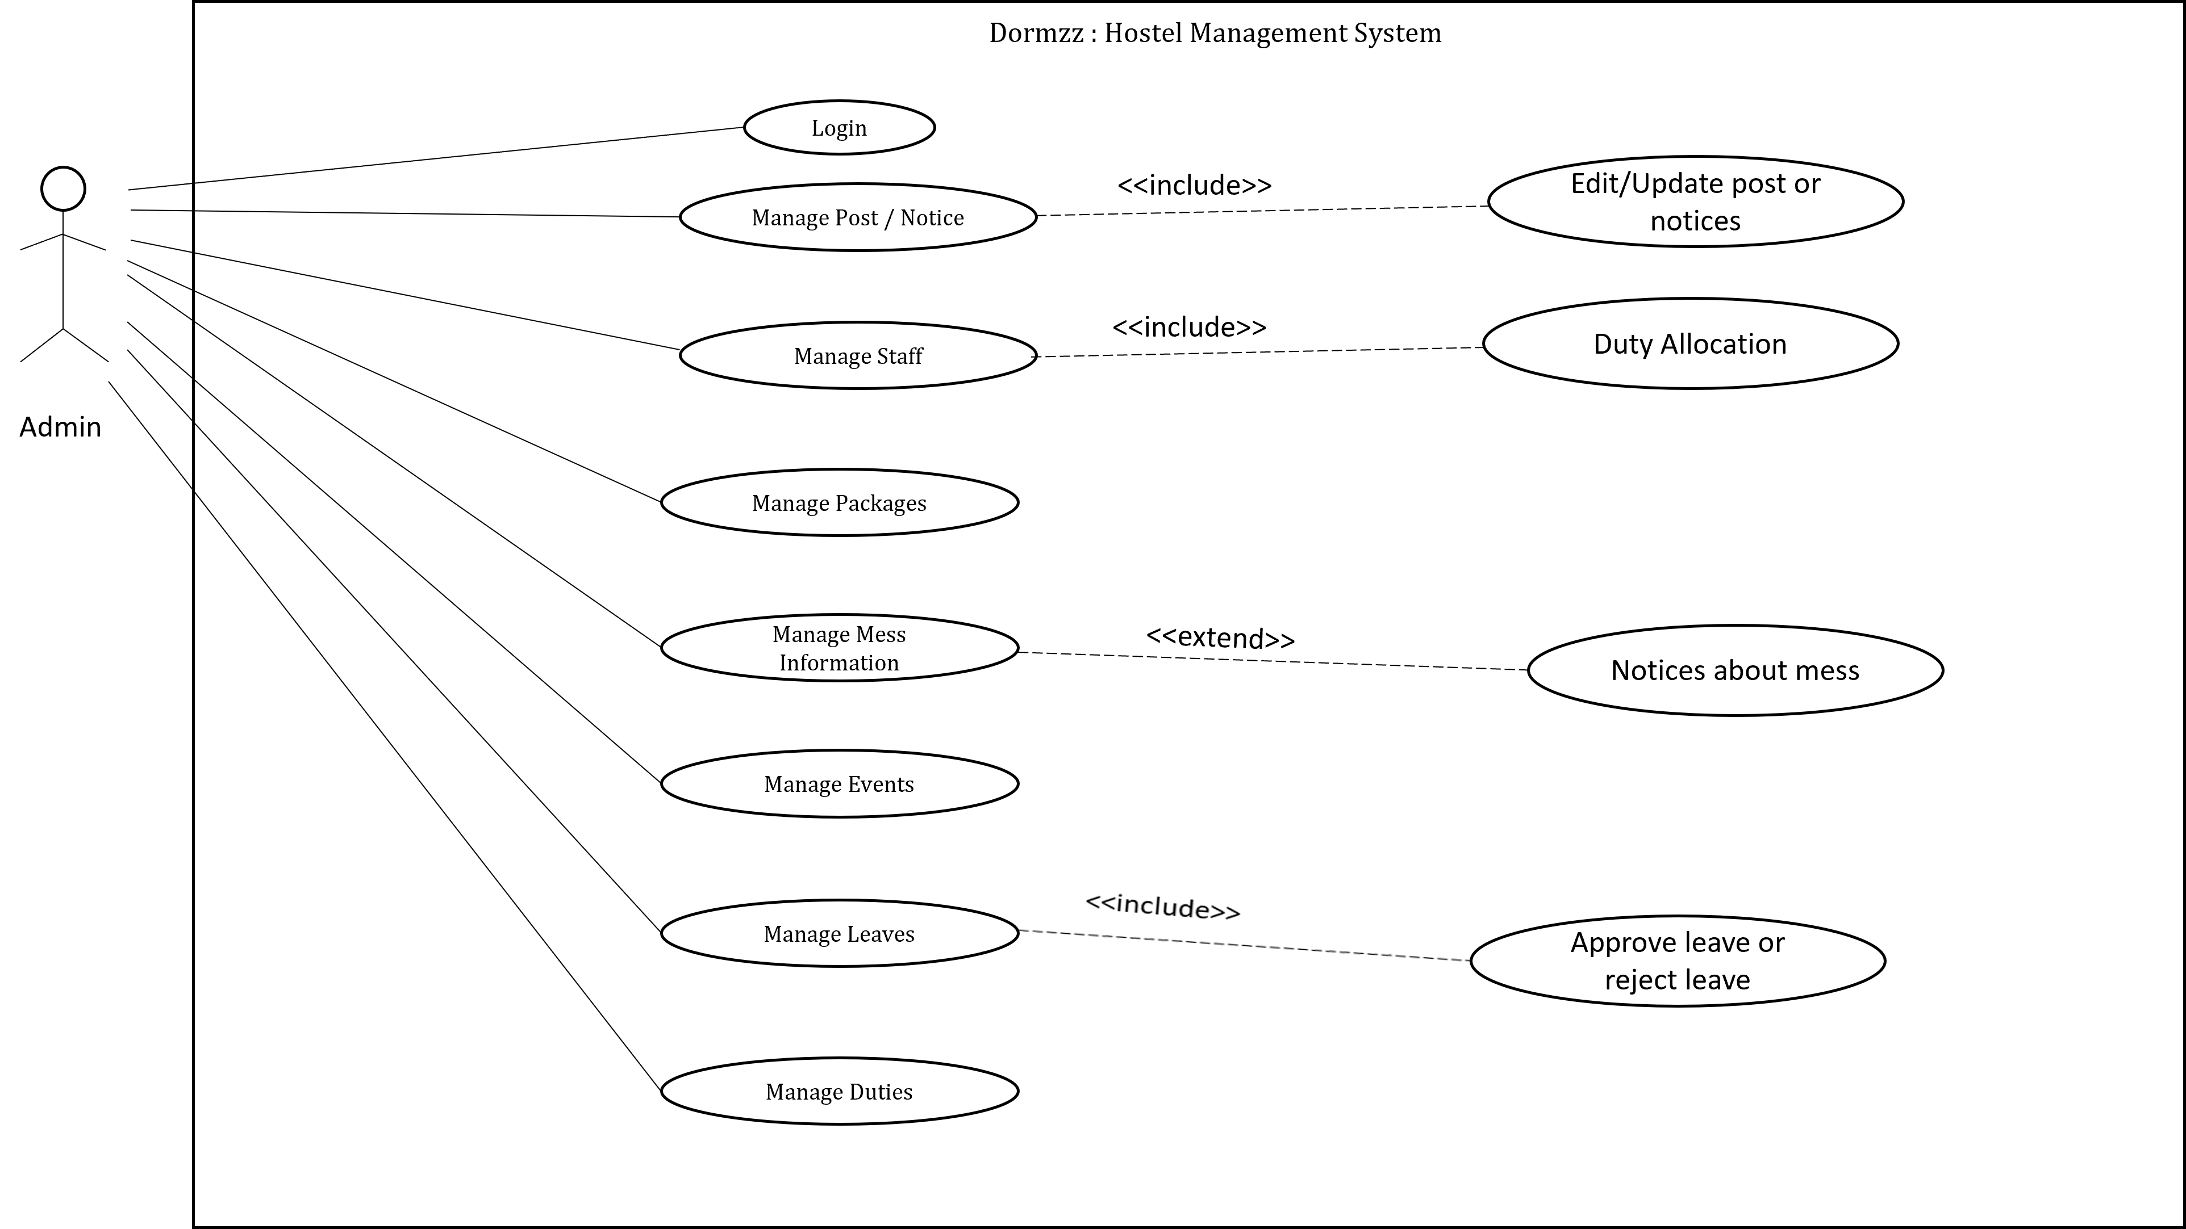
Usecase Diagrams

Slide 37
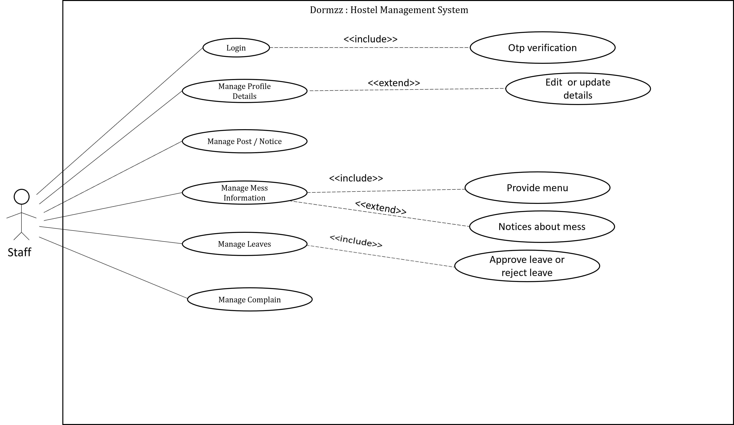
Usecase Diagrams

Slide 38
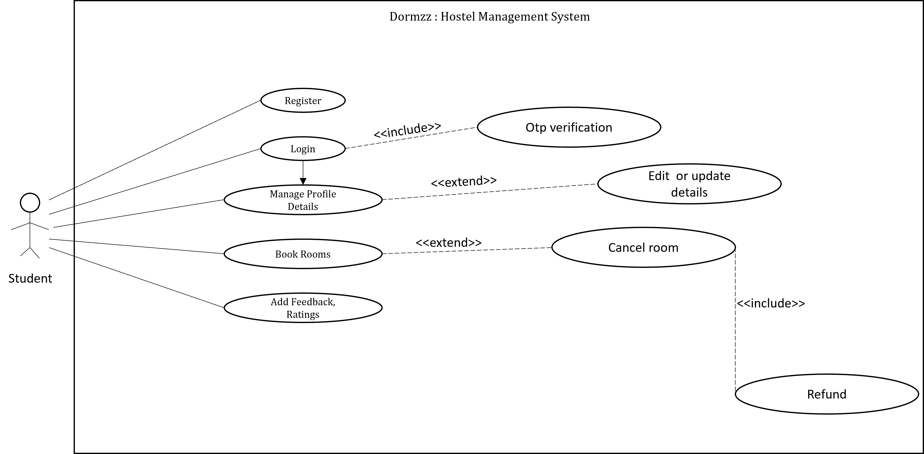
Usecase Diagrams

Slide 39
THANK YOU

